Slide 1
Platt IT Shop
WELCOME
TO INFOTAMTION TECH

Slide 2
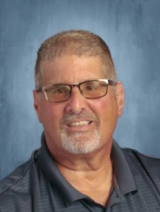
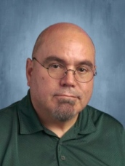
The Instructors
01
02
Thomas Viola
Edward Martinez
Department Head, Information Technology
Instructor, Information Technology
Thomas.Viola@cttech.org
Edward.Martinez@cttech.org
Edward Martinez

Slide 3
01
What We Do Through The Years

Slide 4
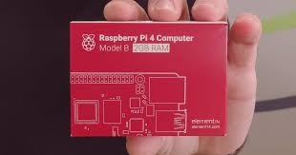
What curriculum for freshman and sophomores
Freshmen->
<-Sophomores
A Little bit

Slide 5
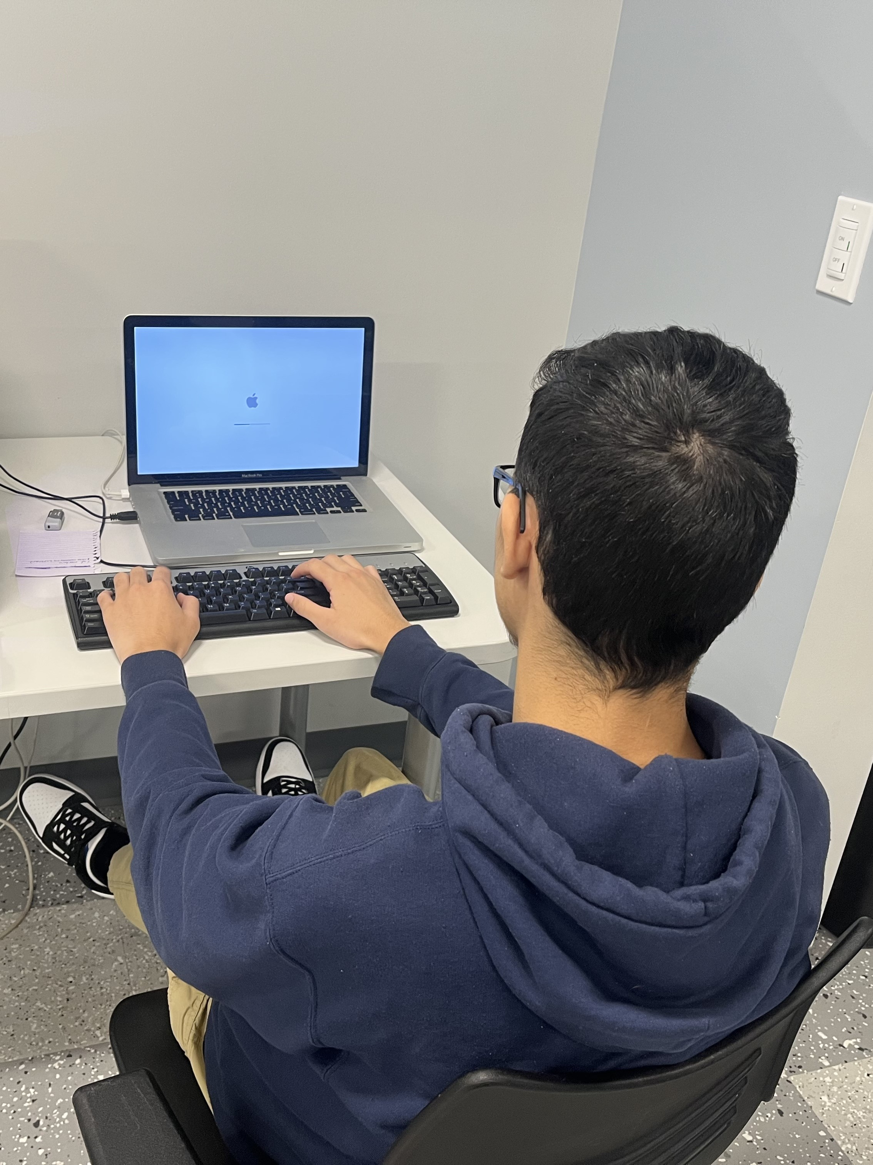
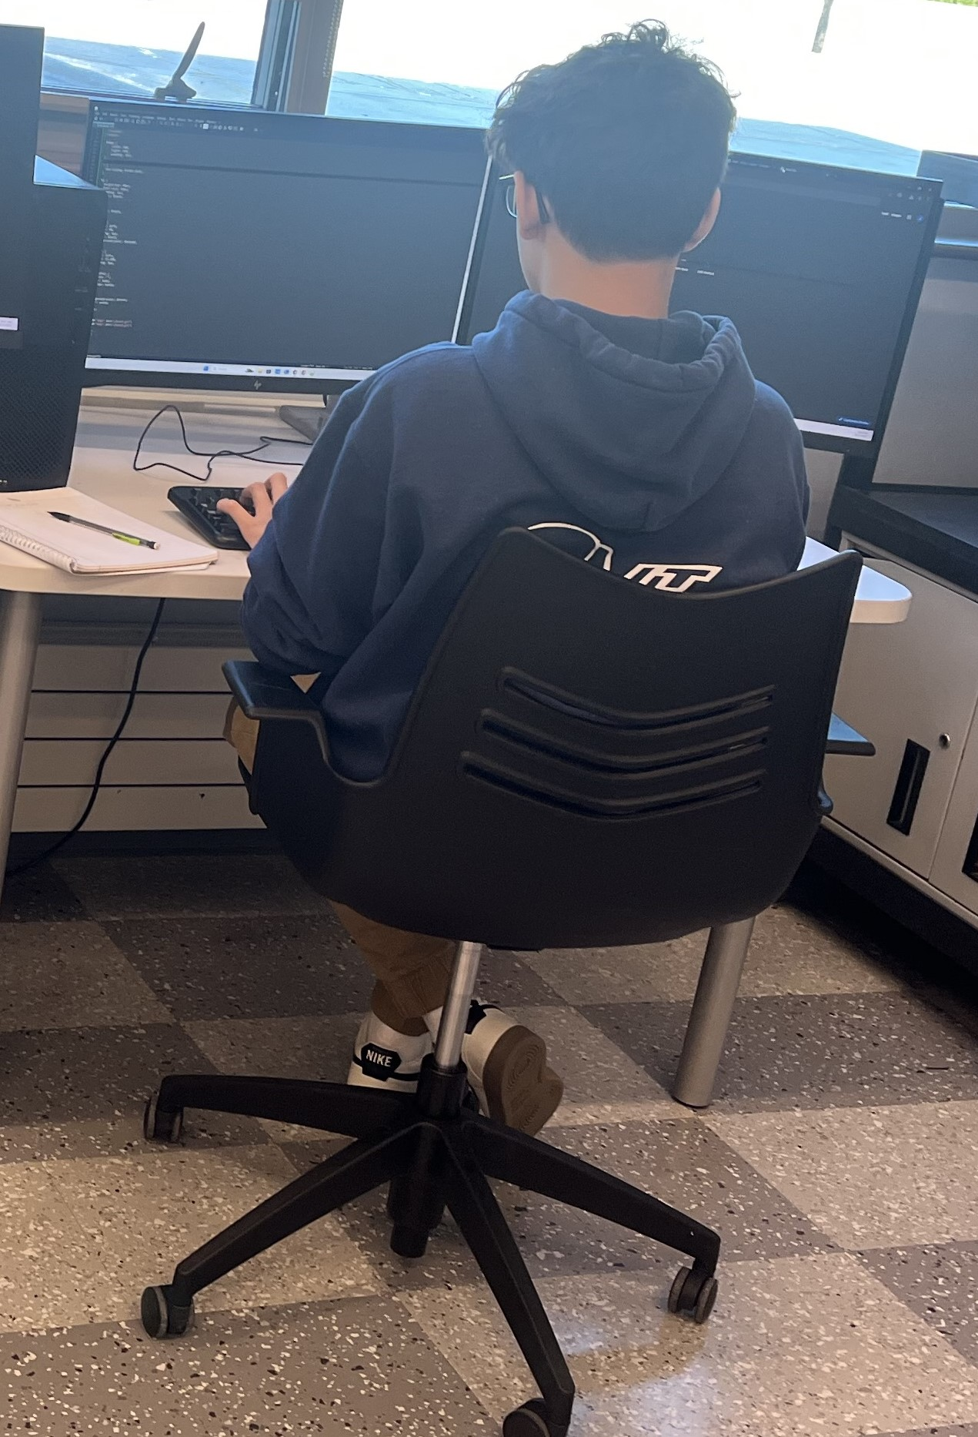
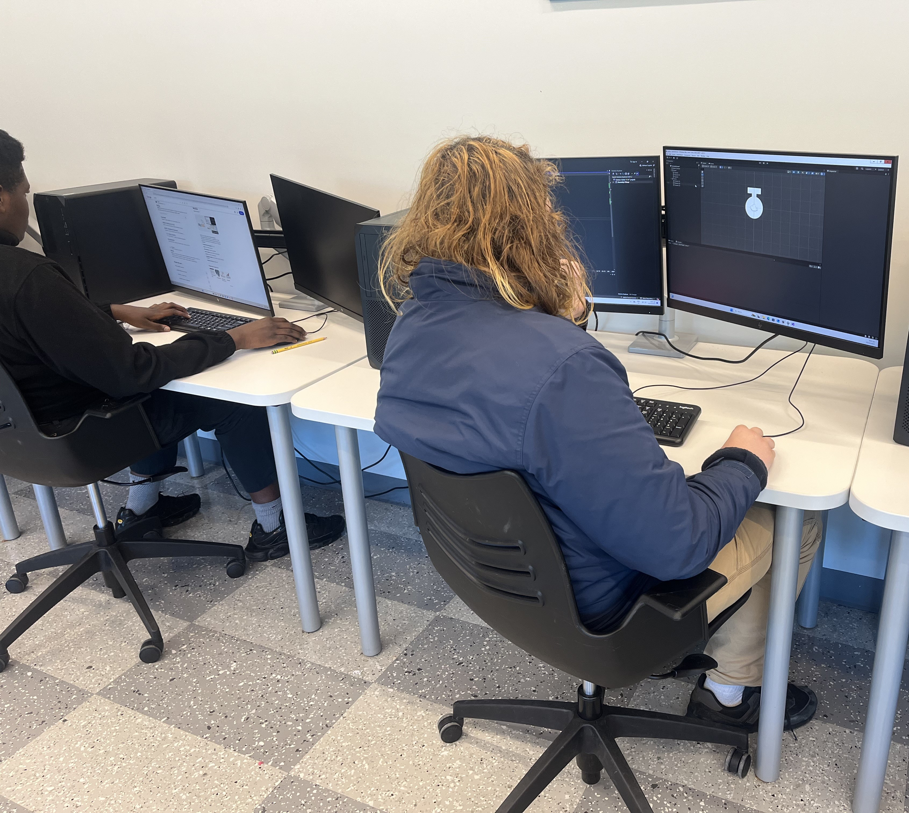
Our Students at work
Sophomore Class
Juniors Class

Slide 6
Senior PROJECT
Senior Project is a Project that when you are a senior you pick something you want to do in Life and you start doing a project that will last the whole senior year in IT

Slide 7
What curriculum Juniors are doing
Juniors >
And Certificates

Slide 8
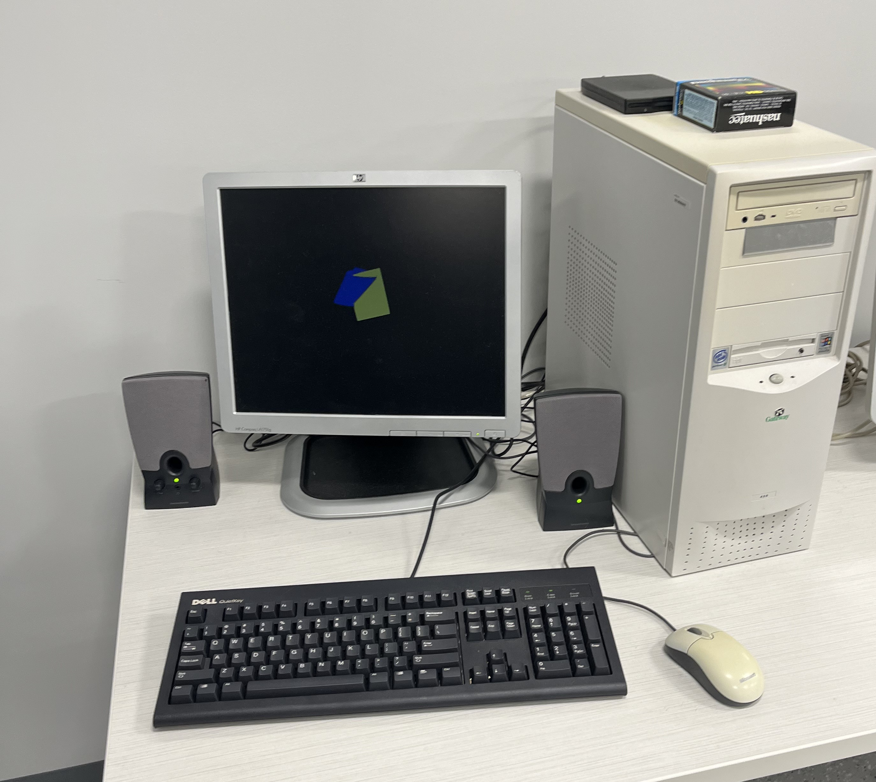
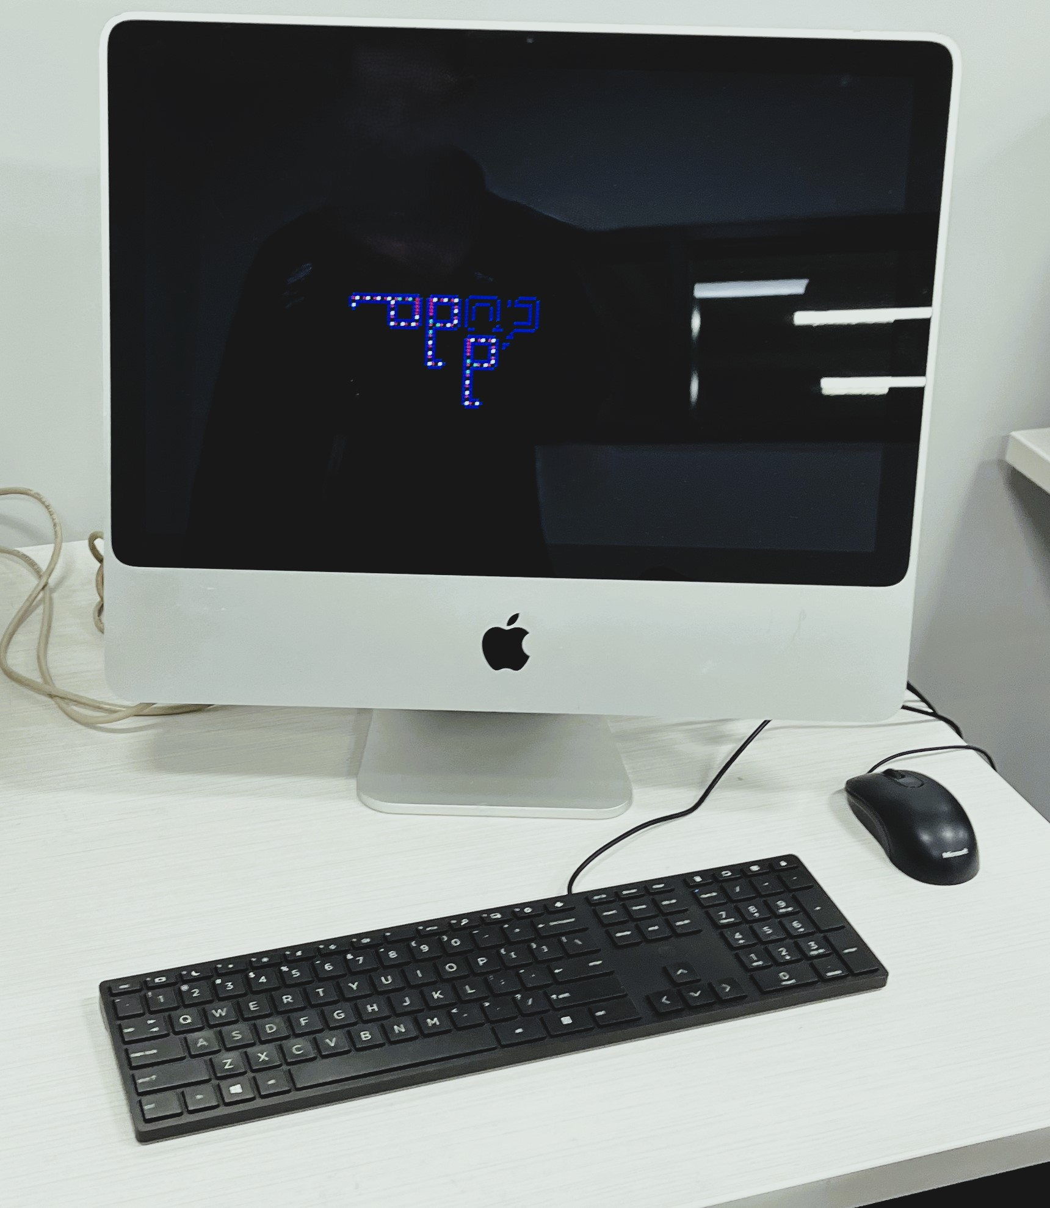
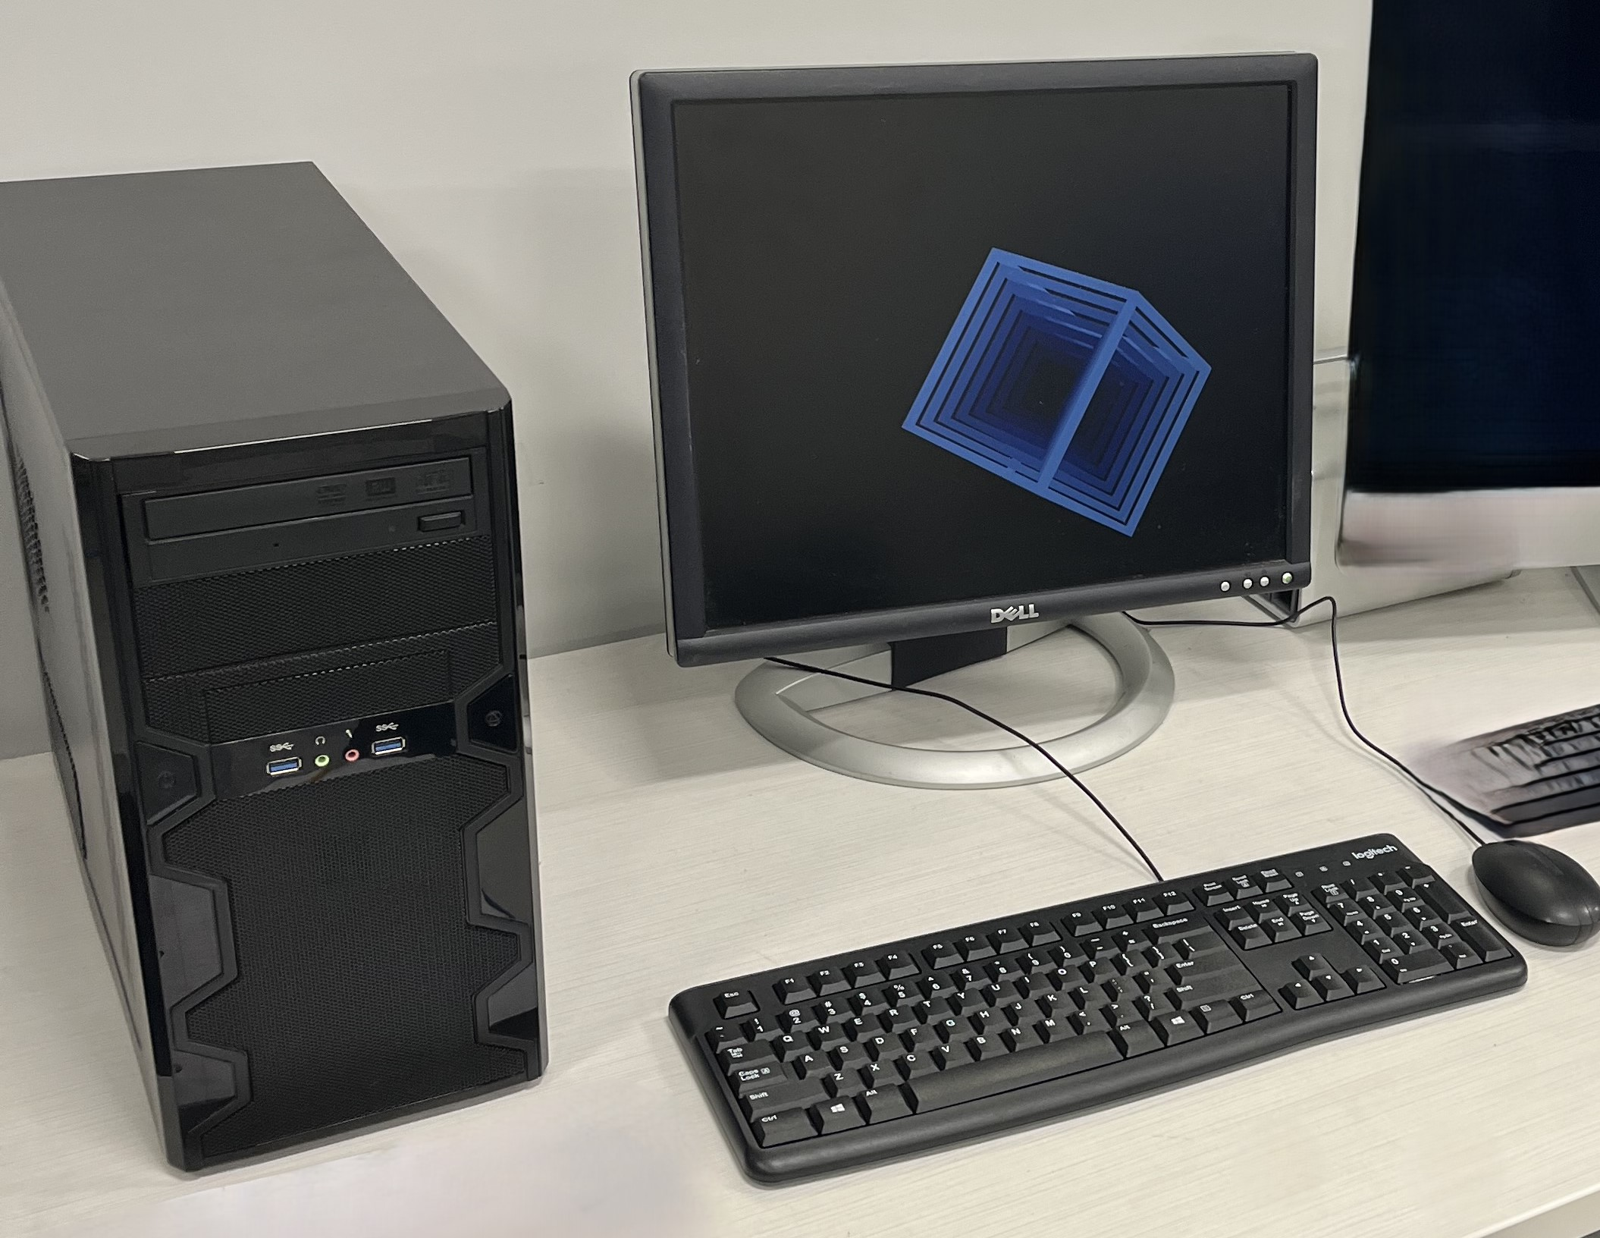
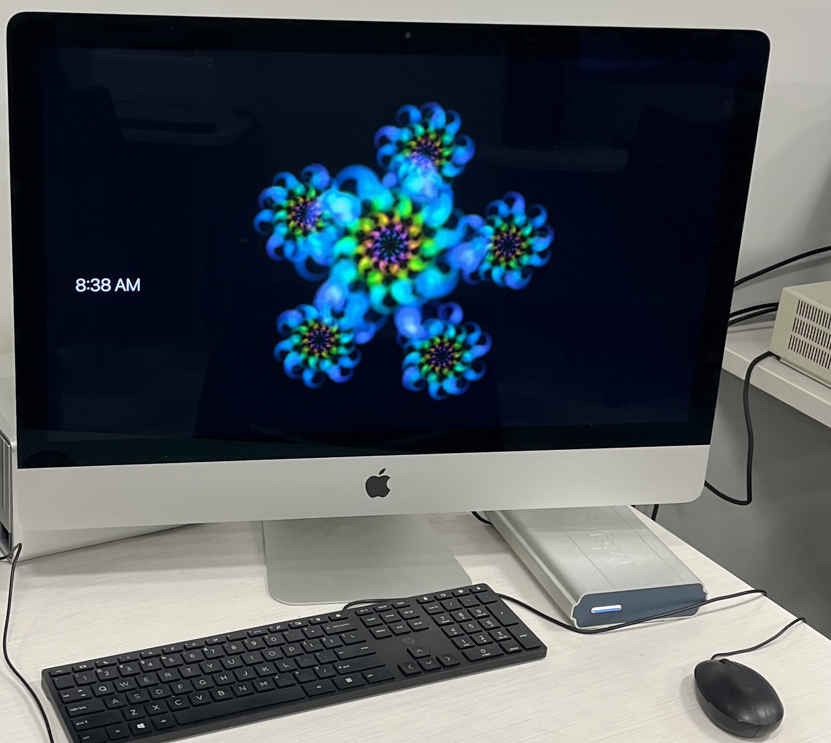
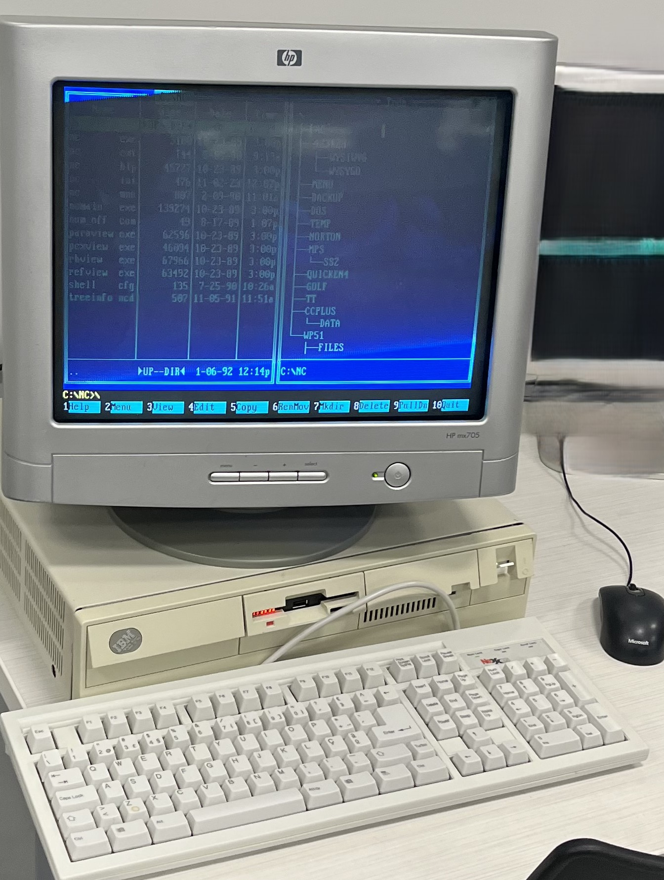
Computer
GALLERY
PRODUCT 01
PRODUCT 02
PRODUCT 03
PRODUCT 04
PRODUCT 05

Slide 9
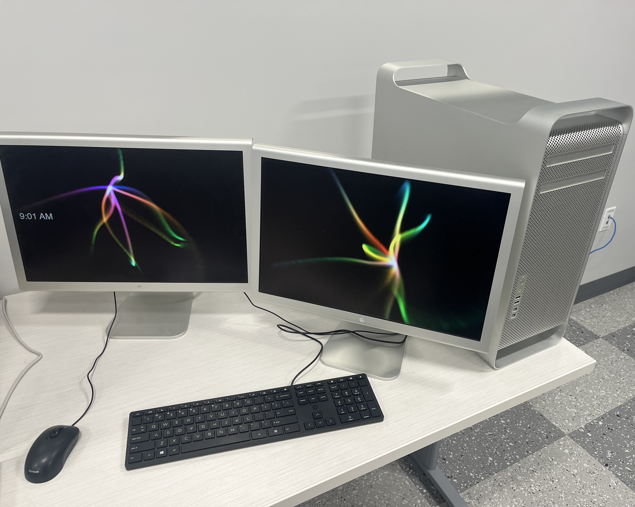
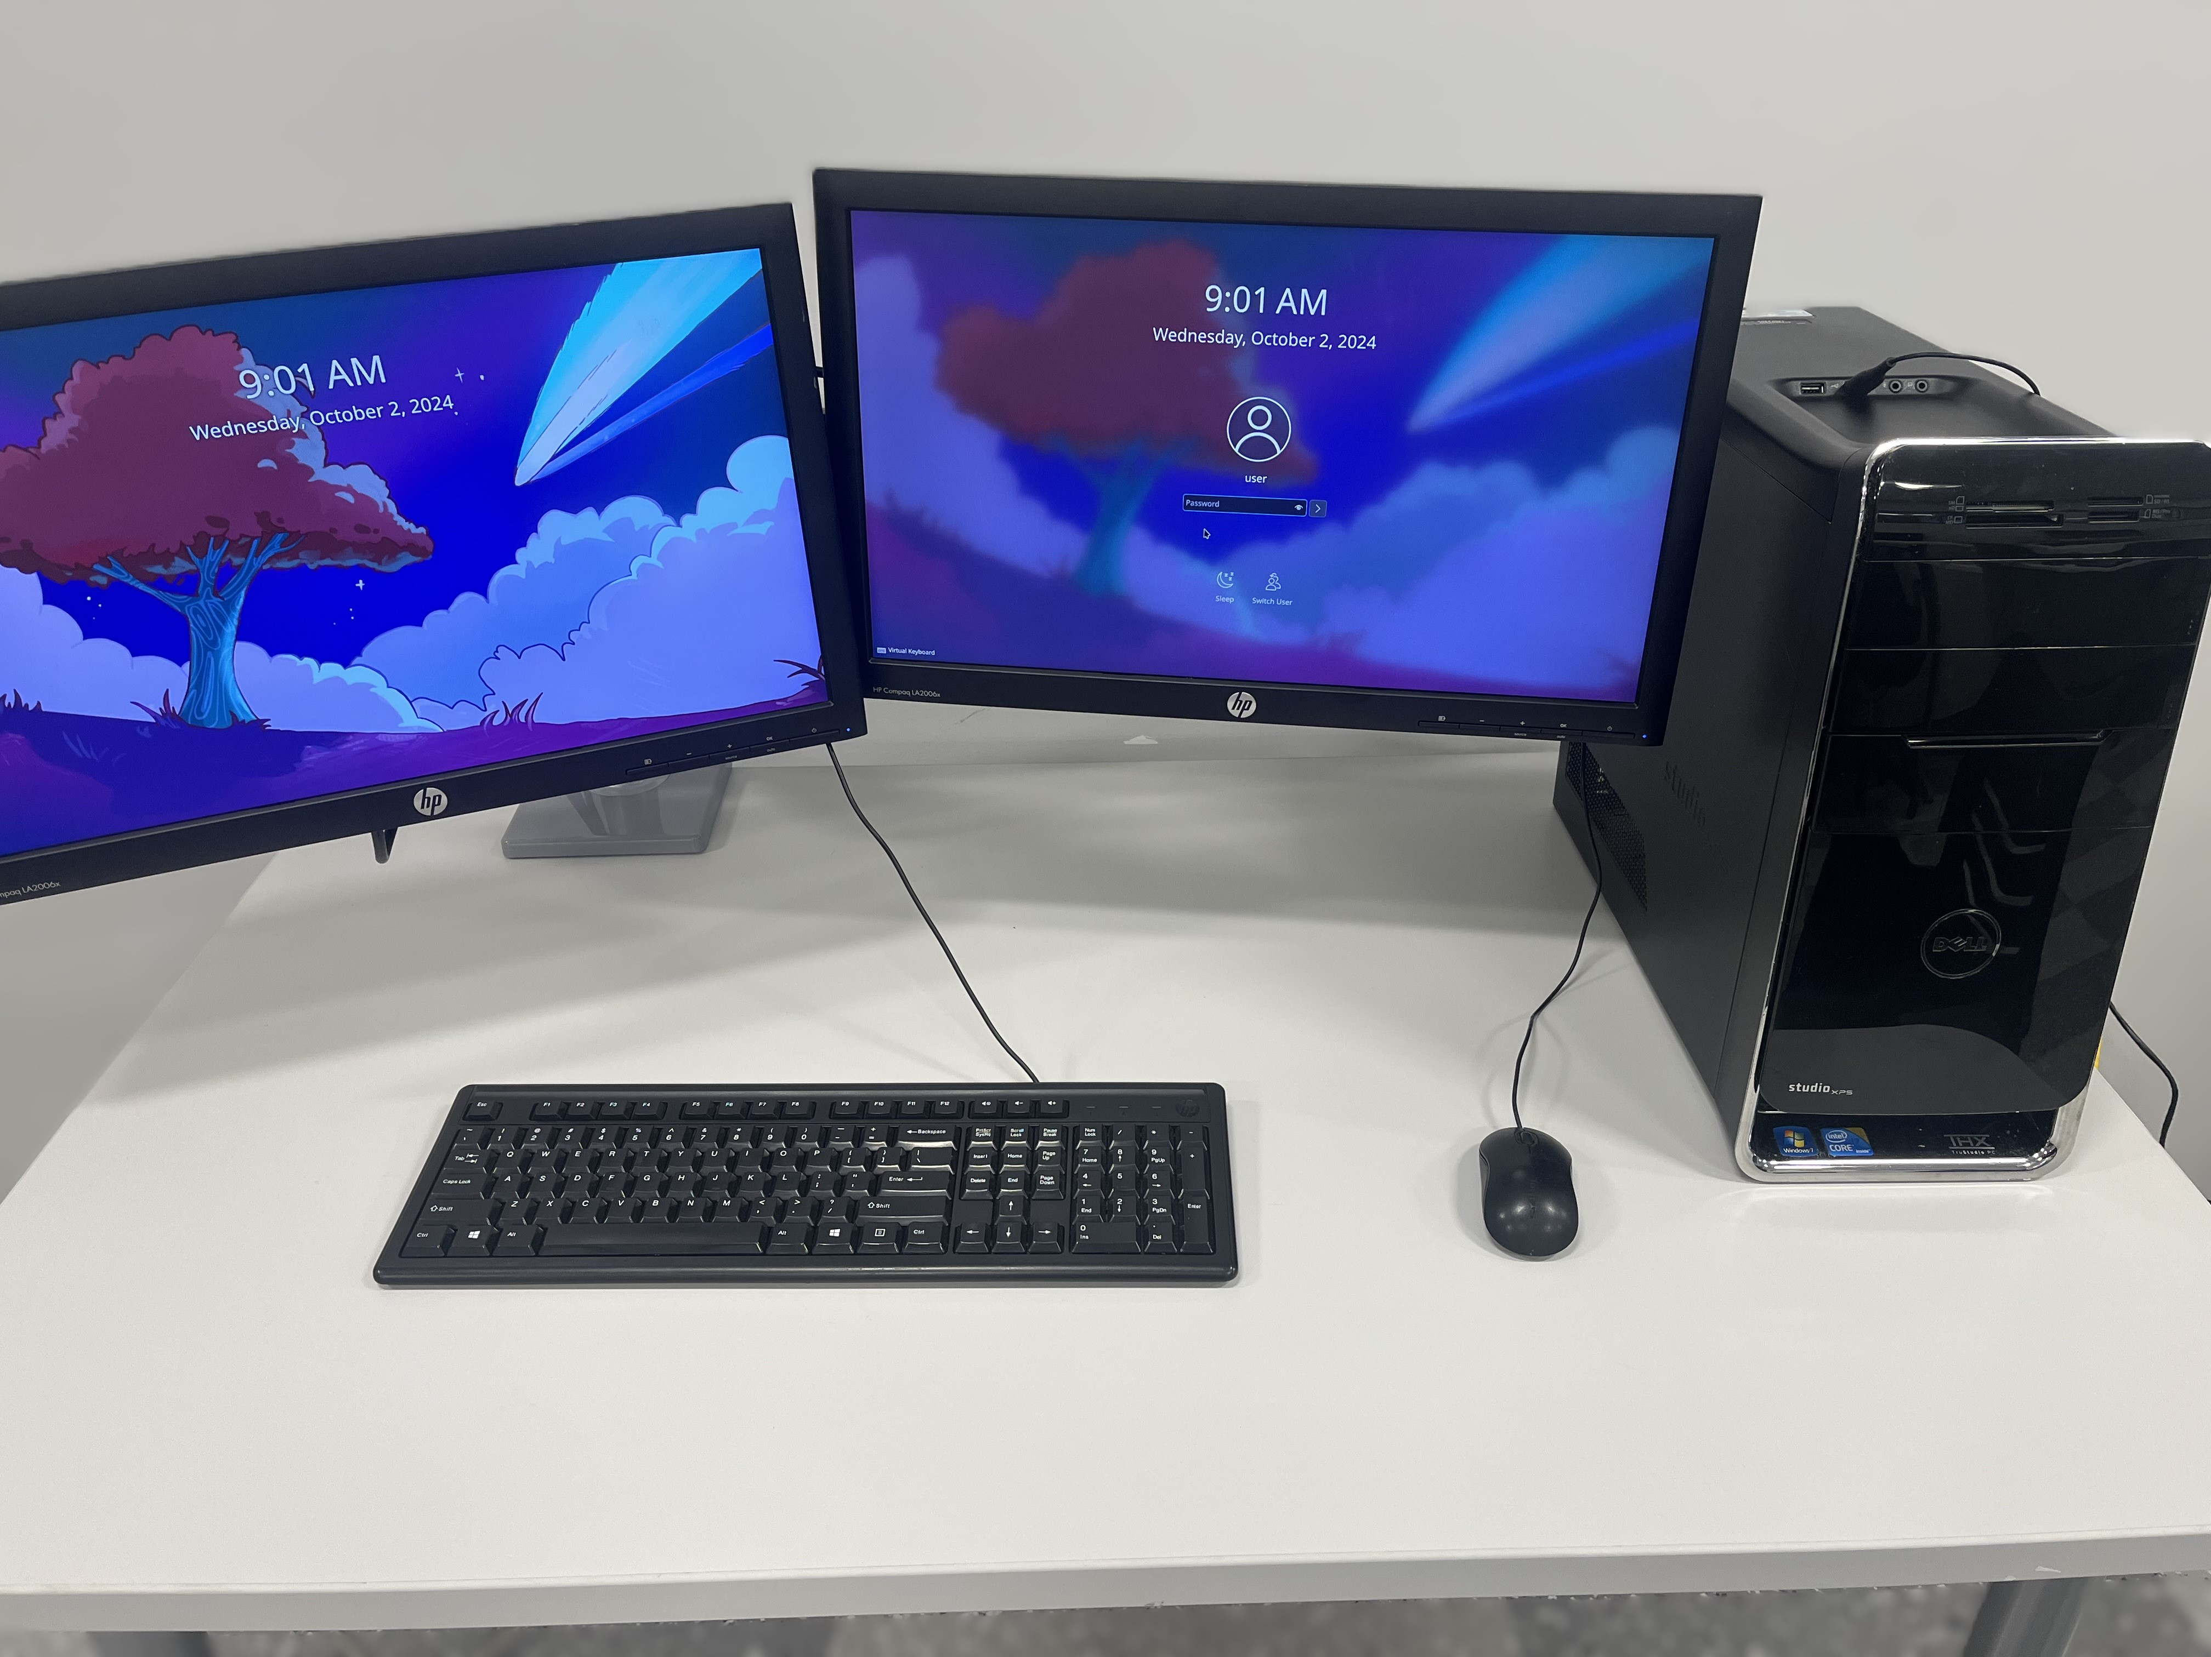
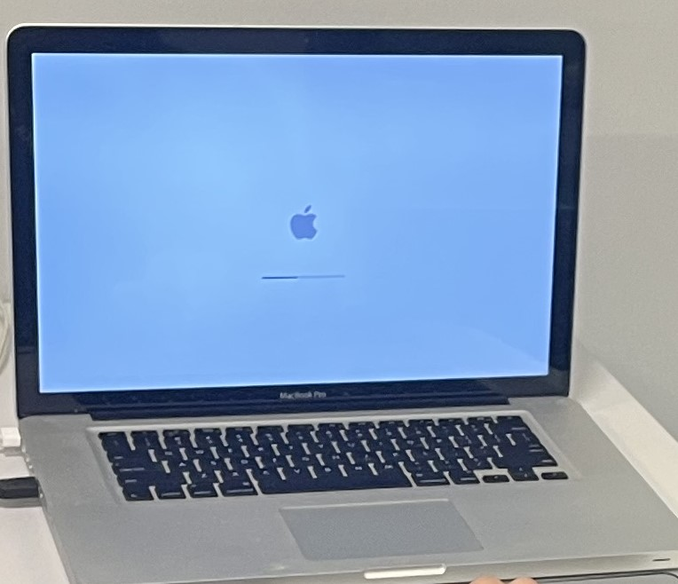
Coputer
GALLERY
PRODUCT 01
PRODUCT 02
PRODUCT 03
PRODUCT 04
PRODUCT 05

Slide 10
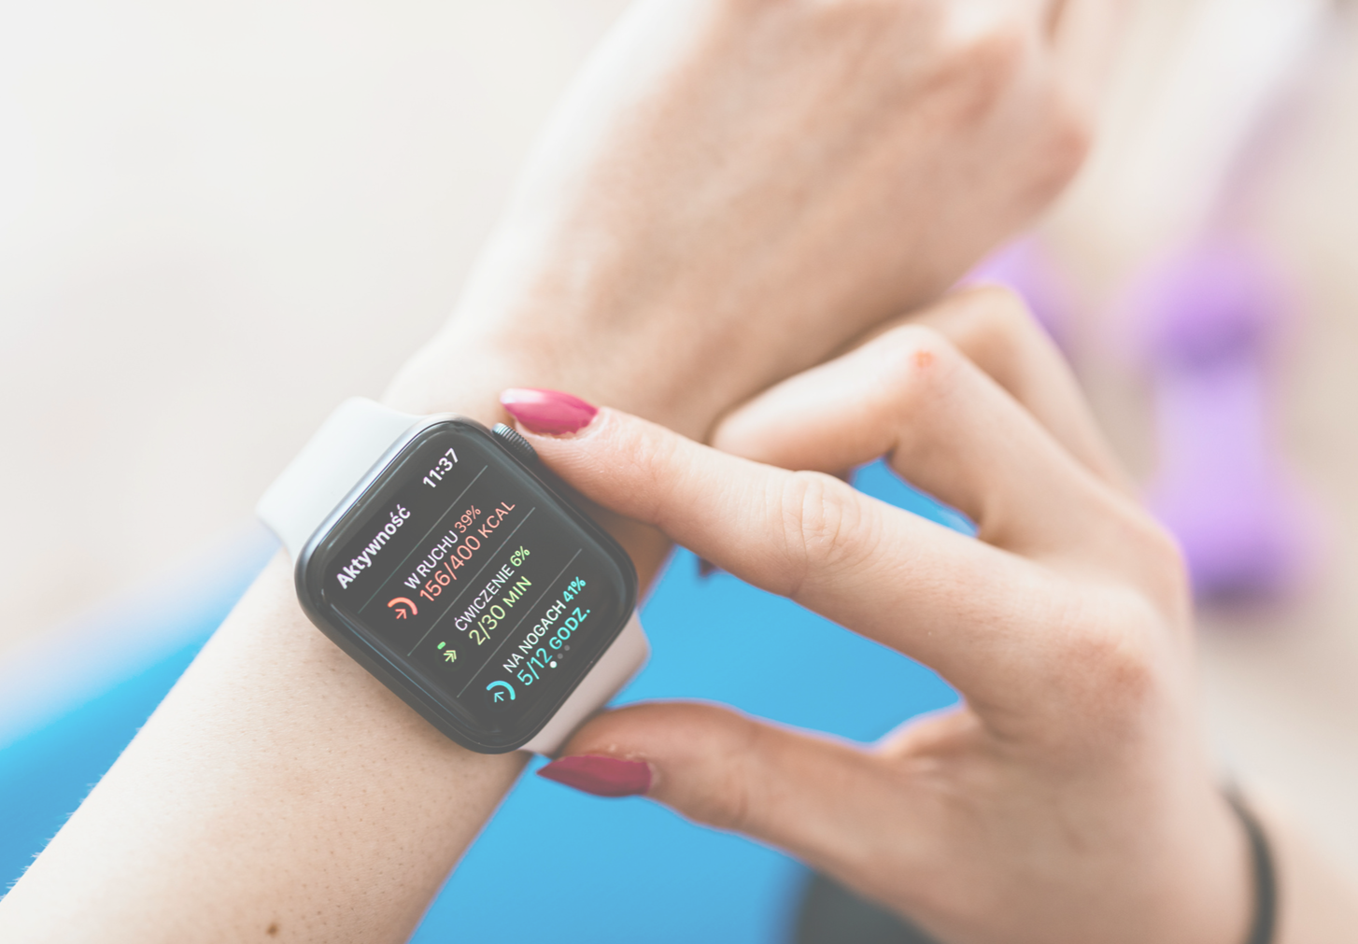
I.T. Fixing Needs Contact
Thomas Viola
Edward Martinez
(203) 783-5375
(203) 783-5375
Thomas.Viola@cttech.org
Edward.Martinez@cttech.org

